Slide 1

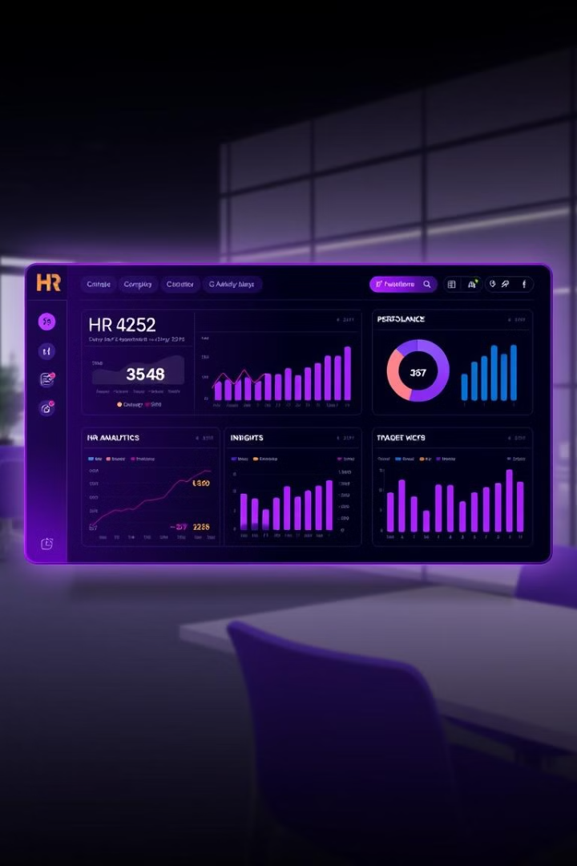

HR Analytics Dashboard: Unlocking Workforce Potential
Transform your HR strategy with data-driven insights. This dashboard empowers you to understand your workforce, improve employee retention, and boost performance.
by ABHISHEK AHER

Slide 2

Key Workforce Metrics
1470
16%
Total Employees
Attrition Rate
A growing organization.
Room for improvement.
37
$6.5K
Avg. Age
Avg. Salary
Experienced team.
Competitive pay.

Slide 3
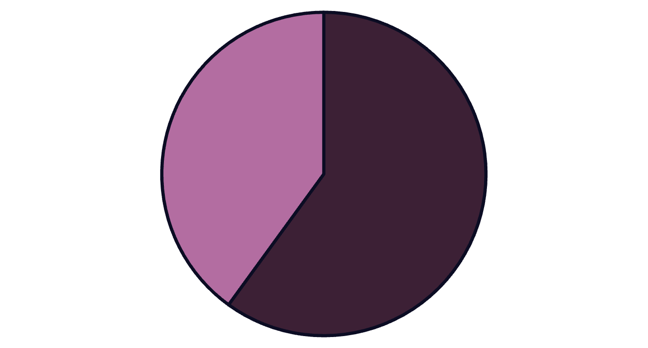
Gender Distribution
Males
Females
The workforce comprises 60% males and 40% females. This distribution provides a foundation for understanding diversity within the organization.

Slide 4

Job Satisfaction Insights
1
Sales Executives
2
Healthcare Reps
Report the highest job satisfaction.
Have higher compensation.
3
Research Directors
Have lower compensation.

Slide 5
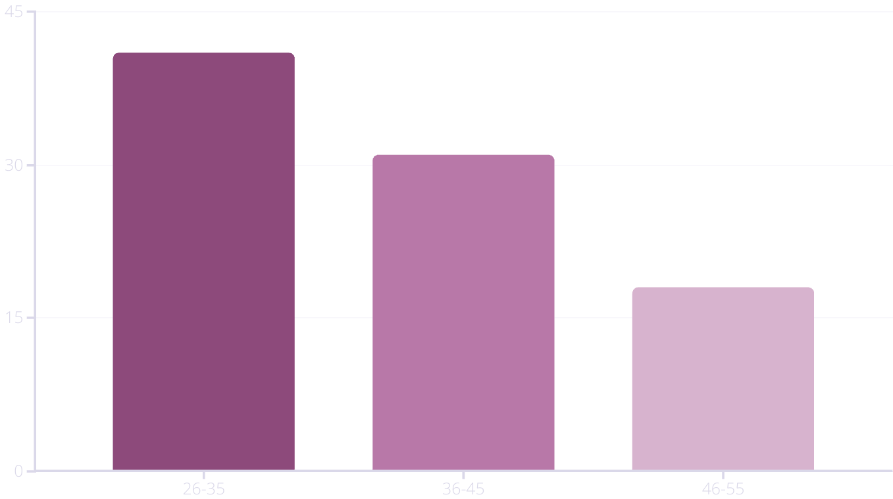
Age Group Distribution
The largest segment (41%) is aged 26-35. The second largest segment (31%) is aged 36-45.

Slide 6
Salary Slabs
Most employees earn up to $5K monthly.
Hourly rates vary between $63.7-$66.8.

Slide 7





Attrition Rate Analysis
Identify Factors
Determine the reasons for attrition.
Implement Strategies
To retain valuable talent.
Monitor Impact
Assess effectiveness of retention efforts.

Slide 8

Recommendations
Tailor HR Strategies
Address Attrition Rate
Review Salary Structures
Based on job satisfaction insights to address employee concerns.
Implement targeted retention programs to reduce employee turnover.
Ensure competitiveness in the market to attract and retain top talent.

Slide 9

Key Takeaways & Next Steps
Leverage data to inform HR decisions.
Prioritize employee satisfaction and retention.
Regularly update the HR analytics dashboard.
Implement recommendations for improvement.

Slide 10
Thank You

